Slide 1


New Years at Times Square

Slide 2


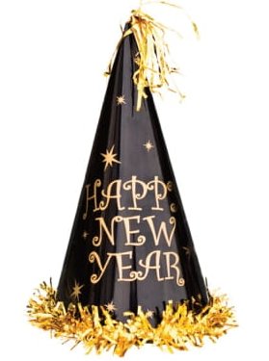

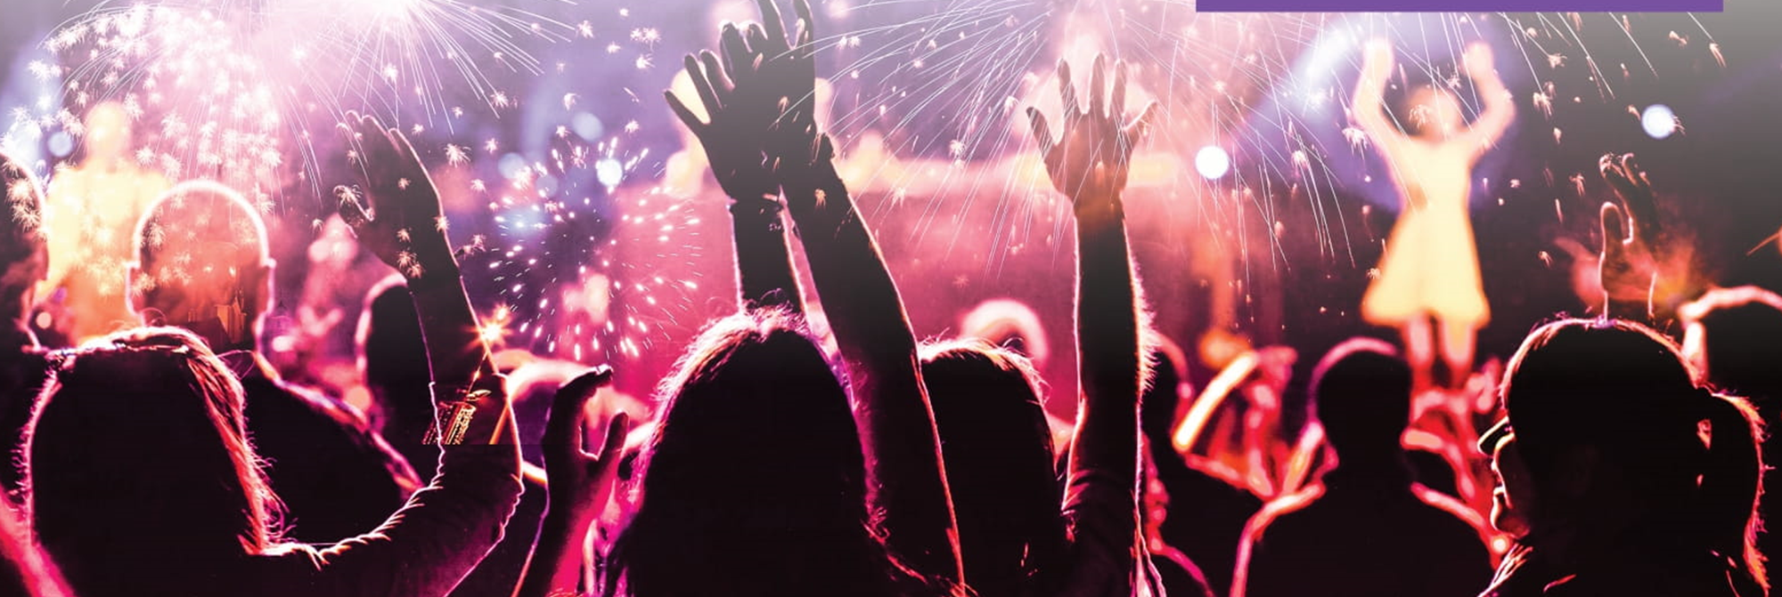

Slide 3
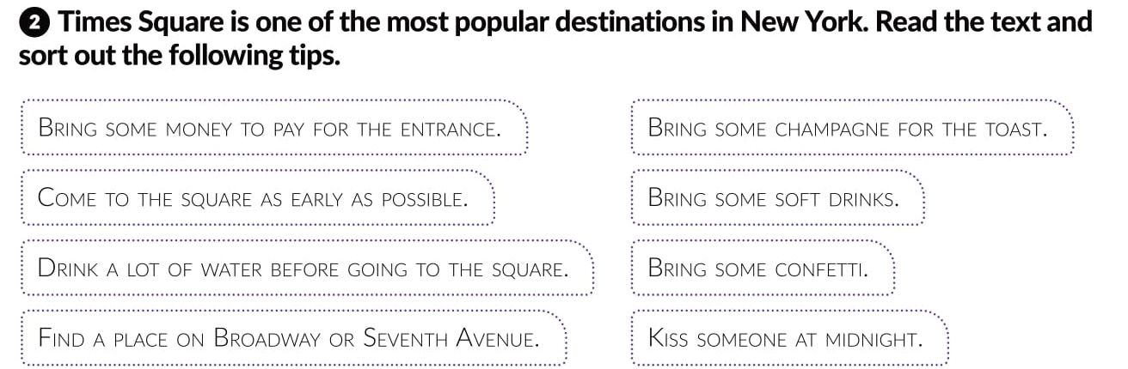
Come to the square as early as possible.
Don’t bring money to pay fo rthe entrance.
Bring some soft drinks.
Don’t drink a lot of water before going to the Square.
Find place on Broadway or Sevent Avenue.
Don’t drink any champagne for the toast.
Kiss someone at midnight.
Don’t bring any confetti.

Slide 4
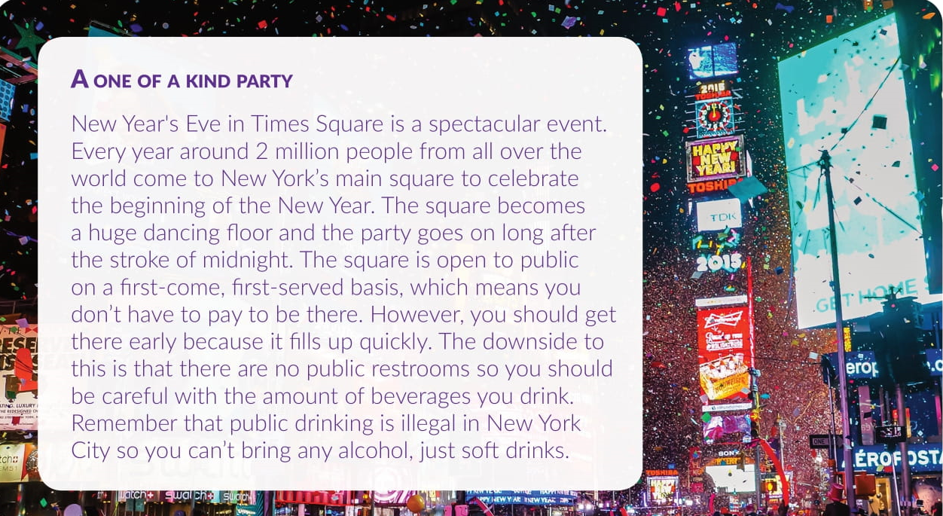

Slide 5
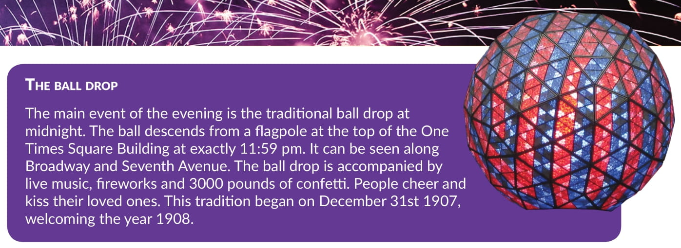

Slide 6
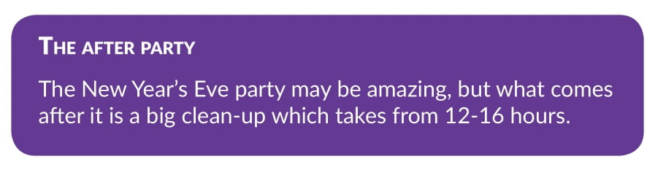
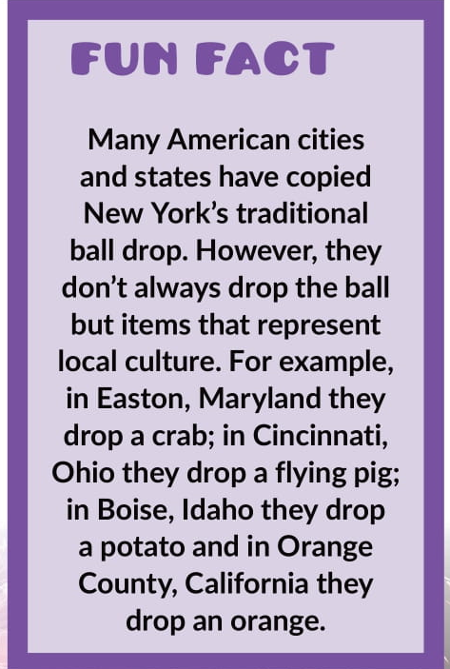

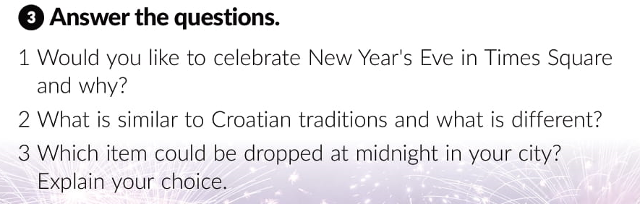

Slide 7
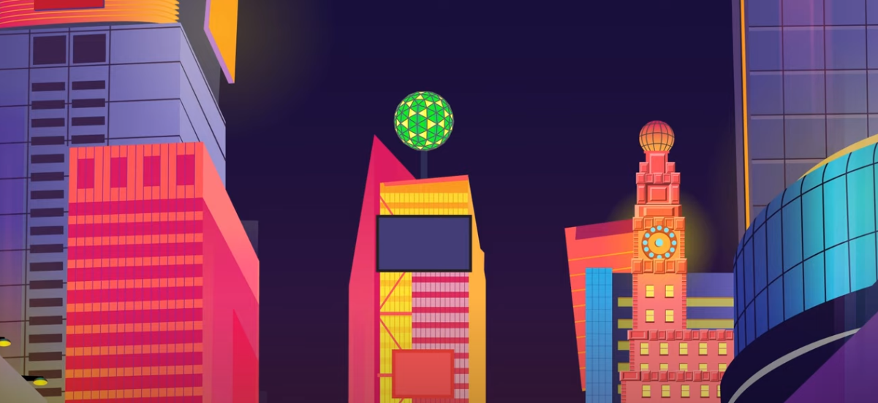
Watch the video about New Year Times Square ball drop.
https://www.youtube.com/watch?v=m4i9kESRbLY&ab_channel=ColossalCranium

